Slide 1
EECT 222 MICROCONTROLLERS
Cohlten Green
Lab Partners:
Nathaniel Paulus
Zachry Francis
Donald Stanley

Slide 2
LAB 1 BASIC STAMP LED FLASHERS

Slide 3
LAB 1 DESCRIPTION
For the first lab, we were to come up with a simple design to learn how to use the basic stamp. We decided to use three LEDs and make them cycle on and off from green to red.

Slide 4
LAB 1 MATERIALS
Item/Component
LED Red
LED Green
LED Yellow
220 Resistor
Basic Stamp Board
Amount
1
1
1
3
1

Slide 5
LAB 1 DATASHEETS
Item/Component
LED Red
LED Green
LED Yellow
220 Resistor
Basic Stamp Board

Slide 6
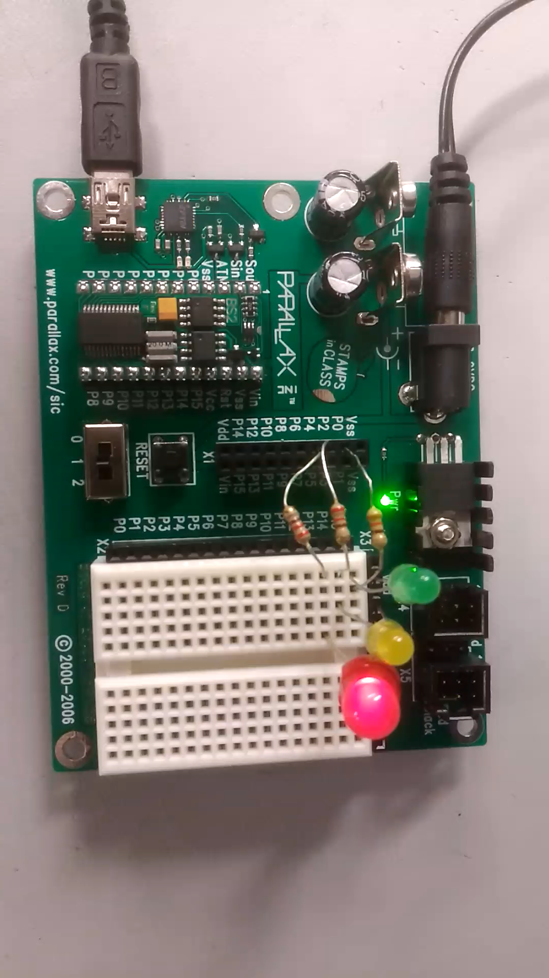
LAB 1 BASIC STAMP LED FLASHERS
' {$STAMP BS2}
' Blinking LEDs
Blink:
LOW 0
PAUSE 100
HIGH 0
LOW 2
PAUSE 100
HIGH 2
LOW 4
PAUSE 100
HIGH 4
GOTO Blink
Basic Stamp Code
Video

Slide 7
LAB 1 BASIC STAMP LED FLASHERS OBSERVATIONS
Fairly easy lab. The coding was pretty easy to figure out. Not to mention there wasn’t much that we actually had to code to make the LED’s flash.

Slide 8
LAB 2 BASIC STAMP SEVEN SEGMENT COUNTER

Slide 9
LAB 2 DESCRIPTION
For this lab, we were to make a seven segment display using the Basic Stamp. We also decided to have the display count up from 0-9.

Slide 10
LAB 2 MATERIALS
Item/Component
220 Resistor
Seven Segment Display
Basic Stamp Board
Amount
7
1
1

Slide 11
LAB 2 DATASHEETS
Item/Component
220 Resistor
Seven Segment Display
Basic Stamp Board

Slide 12
LAB 2 CODE
' {$STAMP BS2}
' Blink an LED
loop:
GOSUB zero
PAUSE 1000
GOSUB off
GOSUB one
PAUSE 1000
GOSUB off
GOSUB two
PAUSE 1000
GOSUB off
GOSUB three
PAUSE 1000
GOSUB off
one:
LOW 15
LOW 13
HIGH 14
HIGH 12
HIGH 11
HIGH 7
HIGH 6
RETURN
two:
LOW 12
LOW 15
LOW 14
LOW 7
LOW 6
RETURN
three
GOSUB one
LOW 14
LOW 6
LOW 12
RETURN
four:
GOSUB one
LOW 11
LOW 14
RETURN
five:
GOSUB zero
LOW 14
HIGH 15
HIGH 7
RETURN
six:
GOSUB eight
HIGH 15
RETURN
seven:
GOSUB one
LOW 12
RETURN
eight:
GOSUB zero
LOW 14
RETURN
nine:
GOSUB eight
HIGH 7
RETURN
GOSUB four
PAUSE 1000
GOSUB off
GOSUB five
PAUSE 1000
GOSUB off
GOSUB six
PAUSE 1000
GOSUB off
GOSUB seven
PAUSE 1000
GOSUB off
GOSUB eight
PAUSE 1000
GOSUB off
GOSUB nine
PAUSE 1000
GOSUB off
GOTO loop
off:
HIGH 15
HIGH 14
HIGH 13
HIGH 12
HIGH 11
HIGH 7
HIGH 6
RETURN
zero:
'LOW 15
'LOW 13
GOSUB one
LOW 12
LOW 11
LOW 7
LOW 6
RETURN

Slide 13
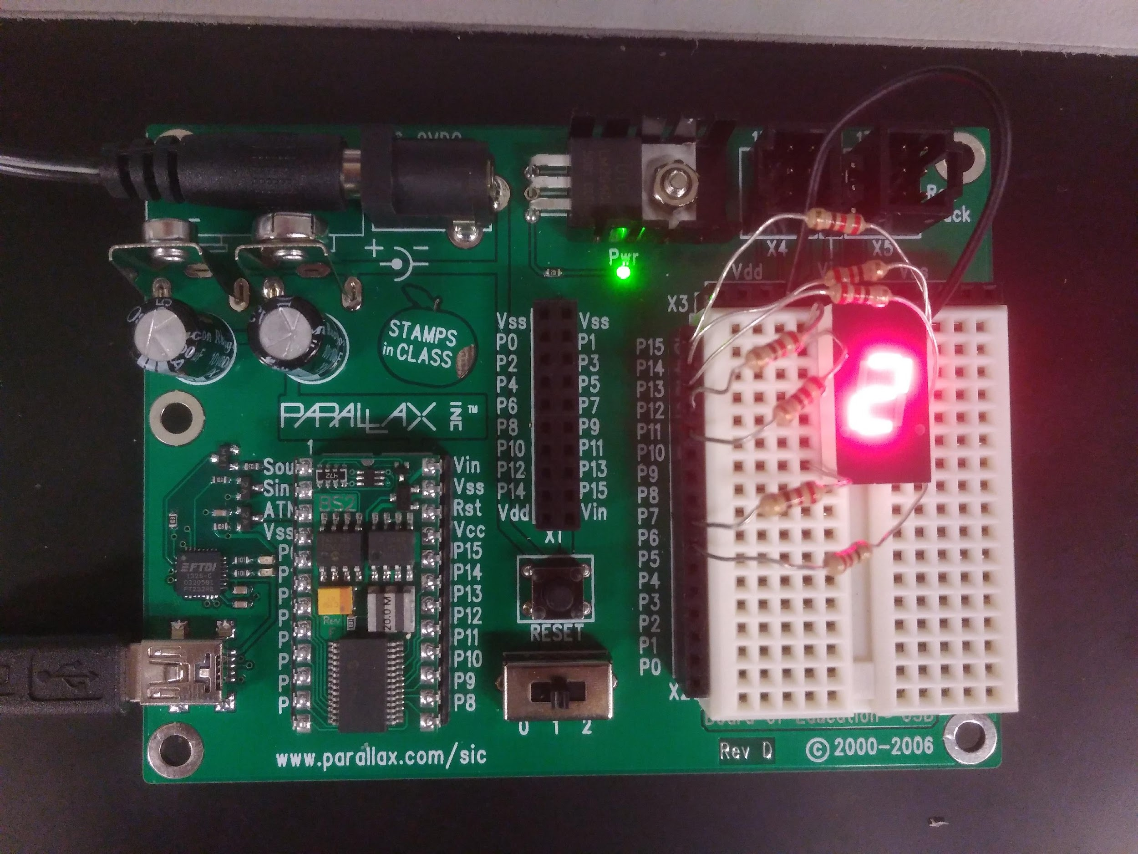
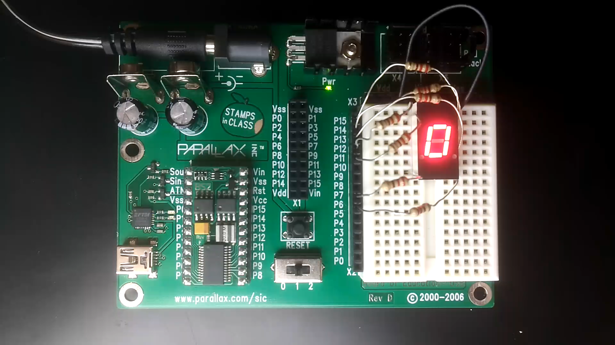
LAB 2
Picture
Video

Slide 14
LAB 2 OBSERVATIONS
This lab was a little more difficult because of the amount of code that we had to write. It was simple code but a lot of repetitive commands for each function.

Slide 15
LAB 3 BOE-BOT

Slide 16
LAB 3 DESCRIPTION
For this lab, we needed to come up with a function for the BOE-BOT to complete. We first figured out how to make the servos run. Then we moved on to setting up the sensors. The sensors were used to follow black tape that we placed on the table and floor.

Slide 17
LAB 3 MATERIALS
Item/Component
BOE-BOT
BOE-BOT Sensors
Black Tape/Electrical Tape
Amount
7
1
1

Slide 18
LAB 3 DATASHEETS

Slide 19
LAB 3 CODE
' {$STAMP BS2}
' {$PBASIC 2.5}
' Pin definitions
lMotor PIN 13
rMotor PIN 12
lSensePwr PIN 7
lSense PIN 8
rSensePwr PIN 10
rSense PIN 9
' Constants
lForward CON 850
lReverse CON 650
rForward CON 650
rReverse CON 850
lStop CON 750
rStop CON 750
i VAR Byte
left VAR Word
right VAR Word
DO
HIGH lSensePwr
HIGH lSense
PAUSE 1
RCTIME lSense, 1, left
LOW lSensePwr
HIGH rSensePwr
HIGH rSense
PAUSE 1
RCTIME rSense, 1, right
LOW rSensePwr
IF left > 1000 THEN
GOSUB TurnLeft
ELSEIF right > 2000 THEN
GOSUB TurnRight
ELSE
GOSUB GOForward
ENDIF
'DEBUG ? left, CR
'DEBUG ? right, CR
'PAUSE 200
LOOP
' PULSOUT 3, 2
' PULSIN 3, 1, sig
' IF sig < 700 THEN
' IF sig // 2 < 1 THEN
' GOSUB TurnRight
' ELSE
' GOSUB TurnLeft
' ENDIF
' ELSE
' GOSUB GoForward
' ENDIF
'LOOP
TurnRight:
FOR i = 1 TO 5
PULSOUT lMotor, lForward
PULSOUT rMotor, rReverse
PAUSE 20
NEXT
RETURN
TurnLeft:
FOR i = 1 TO 5
PULSOUT rMotor, rForward
PULSOUT lMotor, lReverse
PAUSE 20
NEXT
RETURN
GoForward:
FOR i = 1 TO 1
PULSOUT lMotor, lForward
PULSOUT rMotor, rForward
PAUSE 20
NEXT
RETURN
Drive:
j VAR Byte
FOR j = 1 TO 15
GOSUB GoForward
NEXT
RETURN
StopBot:
FOR i = 1 TO 1
PULSOUT lMotor, lStop
PULSOUT rMotor, rStop
PAUSE 20
NEXT
RETURN

Slide 20
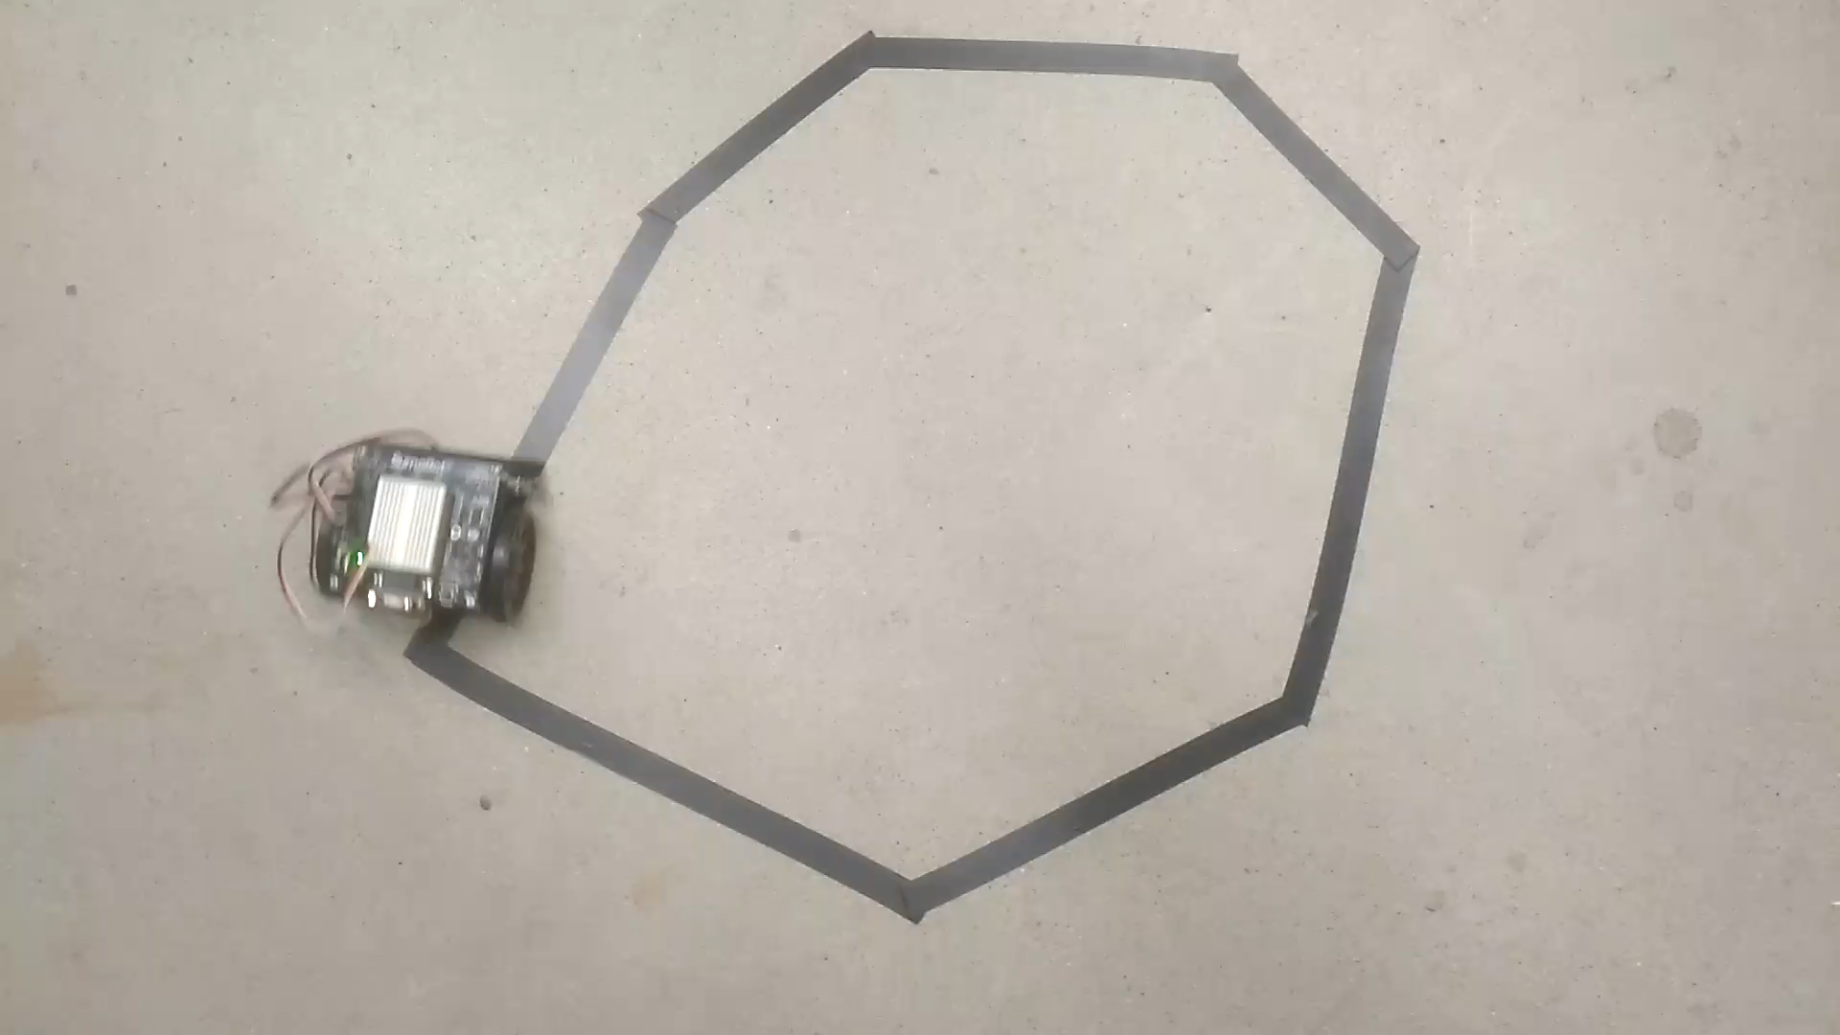
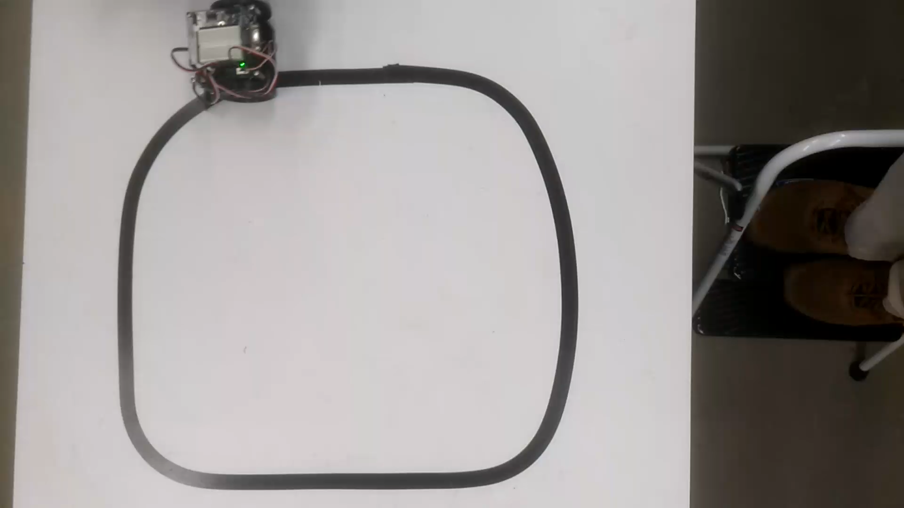
LAB 3
Video
Video

Slide 21
LAB 3 OBSERVATIONS
We had a little bit of a difficult time trying to figure out how to make the boe bot turn the right direction and the certain amount each time. After we figured that out we add the sensor to it so that it would turn when it neared an obstacle.

Slide 22
LAB 4 ARDUINO MESSAGE DISPLAY

Slide 23
LAB 4 DESCRIPTION
For this lab, we were to make a message display using arduino which would display at least 7 different messages by flipping each of the switches.

Slide 24
LAB 4 MATERIALS
Item/Component
Arduino board
Display
220 Resistor
Potentiometer
Set of switches
Amount
1
1
4
1
1

Slide 25
LAB 4 DATASHEET
Item/Component
BOE-BOT
BOE-BOT Sensors
Black Tape/Electrical Tape

Slide 26
LAB 4 CODE
#include
<LiquidCrystal.h>
LiquidCrystal lcd(12, 11, 5, 4, 3, 2);
int msgCode = 0;
int oldMsgCode = -1;
String messages[] =
{
"",
"Out till noon",
"I'm under the\ndesk",
"Grading papers;\ngiving you an F",
"Out skydiving",
"Look behind the\ndoor",
"Destroying your\nhomework",
"Returning the\nnuclear codes",
"Gone fishing",
"This message\ndoes not exist",
"Shutting down\nthe reactor",
"Experimenting\nwith nutrinos",
"Building Skynet",
"Eating PI",
"Napping; back soon",
"Making coffee"
};
void setup()
{
lcd.begin(16, 2);
}
void loop()
{
int result = 0;
for (int i = 3; i >= 0; i--)
{
result *= 2;
result += analogRead(i) > 512 ? 1 : 0;
}
msgCode = result;
if (msgCode != oldMsgCode)
{
int newLine = messages[msgCode].indexOf('\n');
String a = newLine == -1 ? messages[msgCode] : messages[msgCode].substring(0, newLine);
String b = newLine == -1 ? "" : messages[msgCode].substring(newLine + 1);
oldMsgCode = msgCode;
lcd.clear();
lcd.setCursor(0, 0);
lcd.print(a);
lcd.setCursor(0, 1);
lcd.print(b);
}}

Slide 27
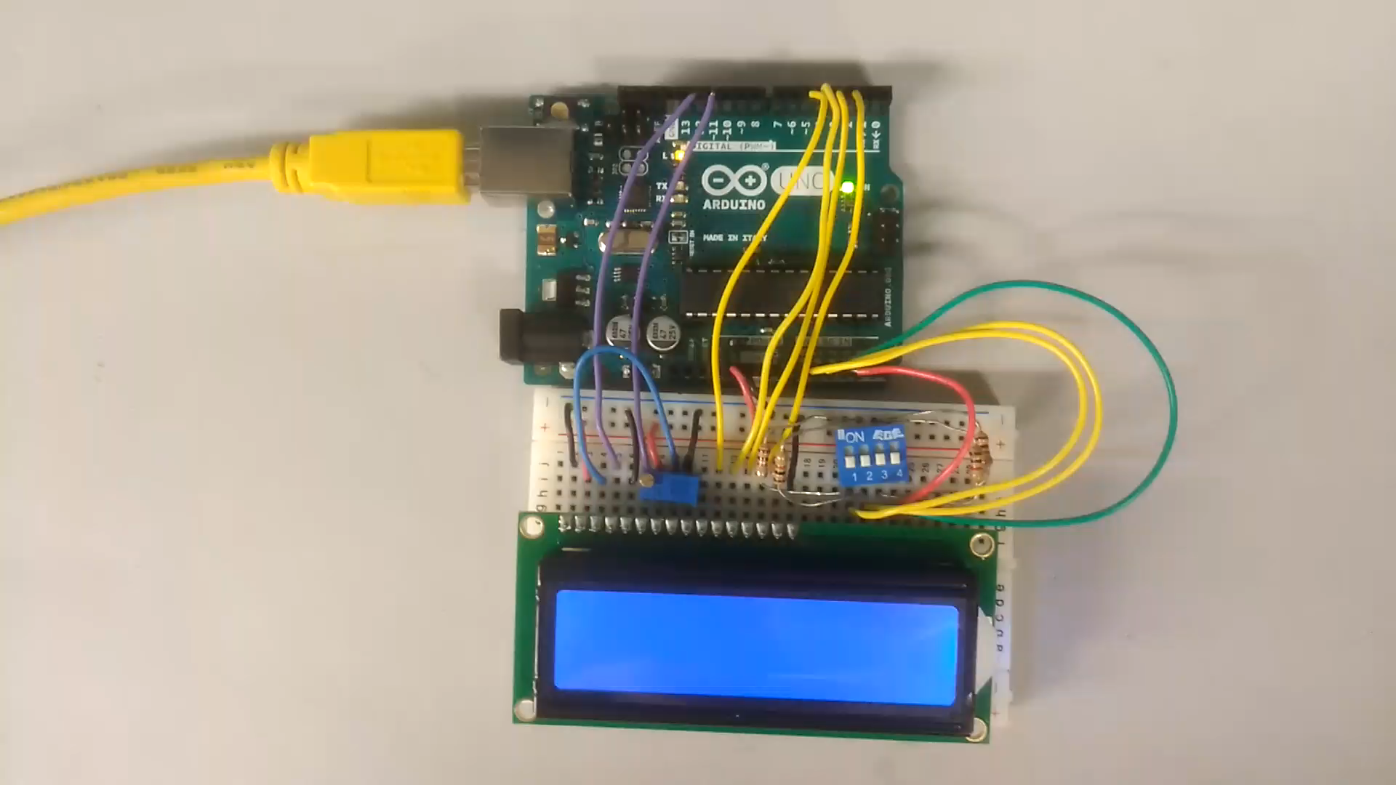
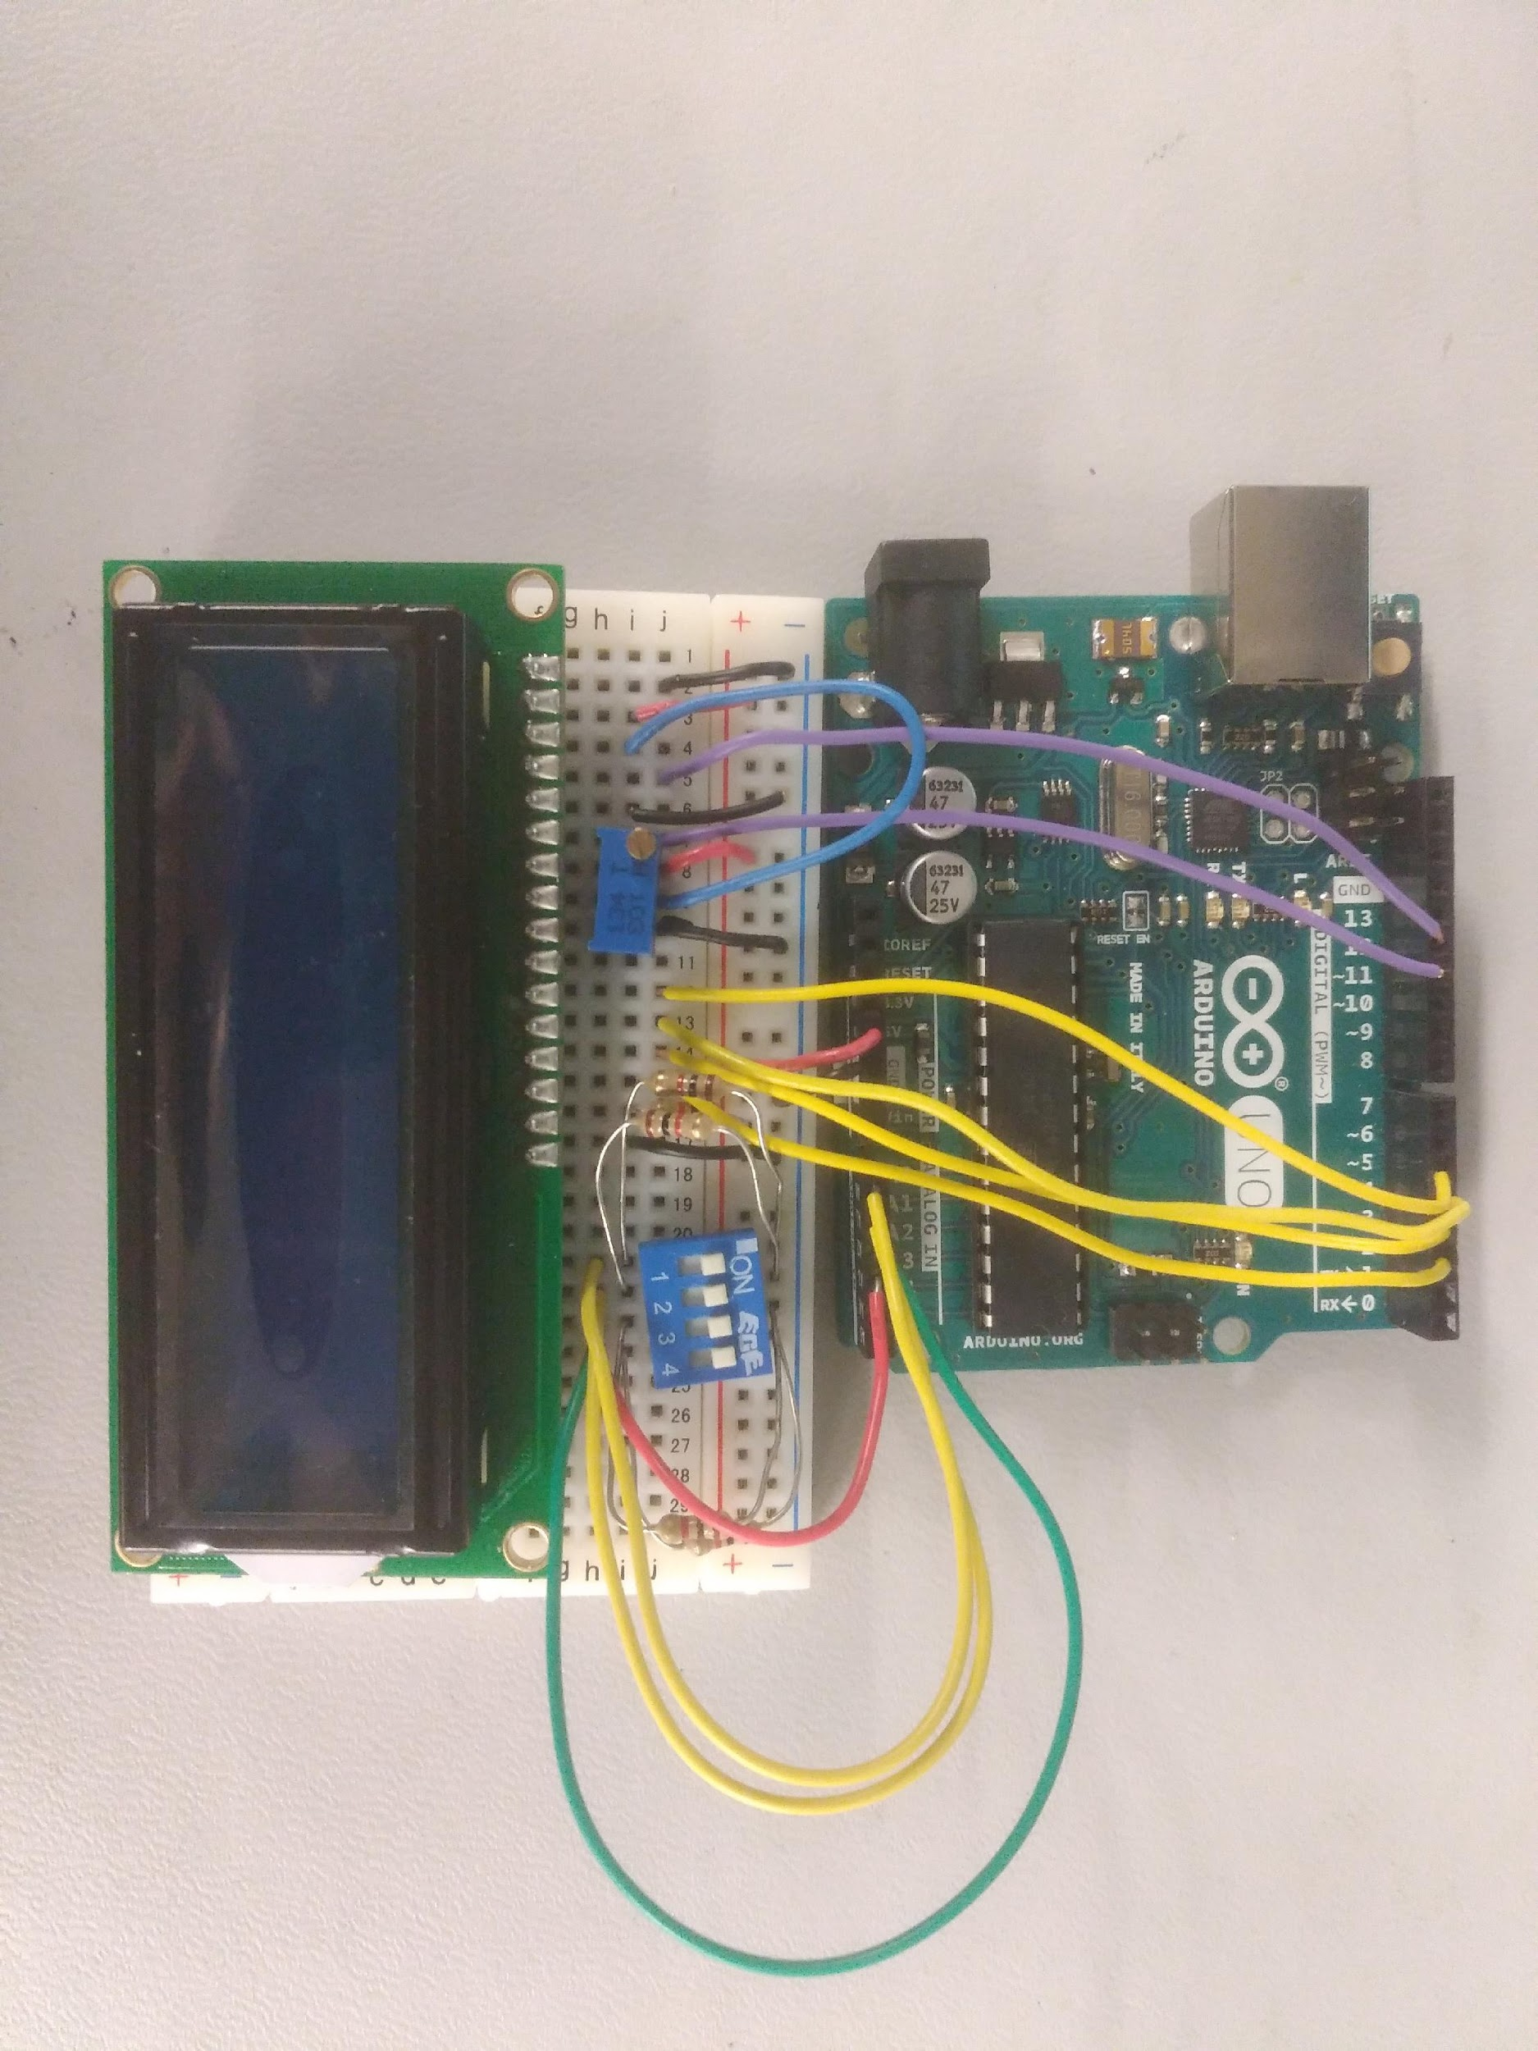
LAB 4 - Prototype
Picture
Video

Slide 28
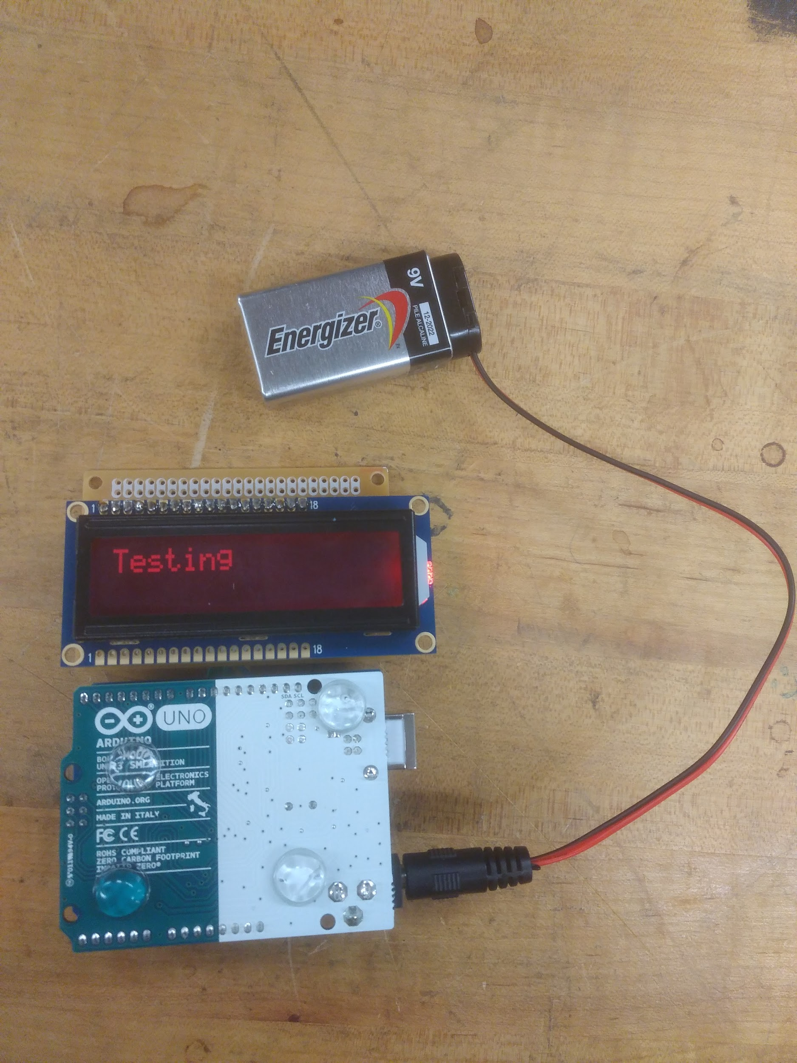
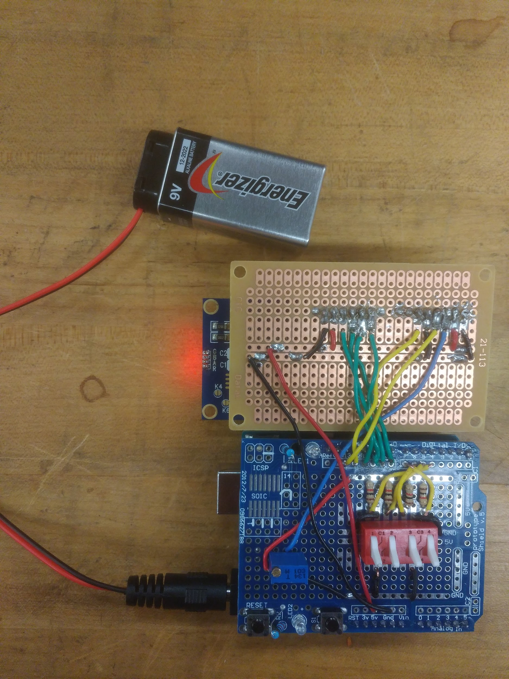
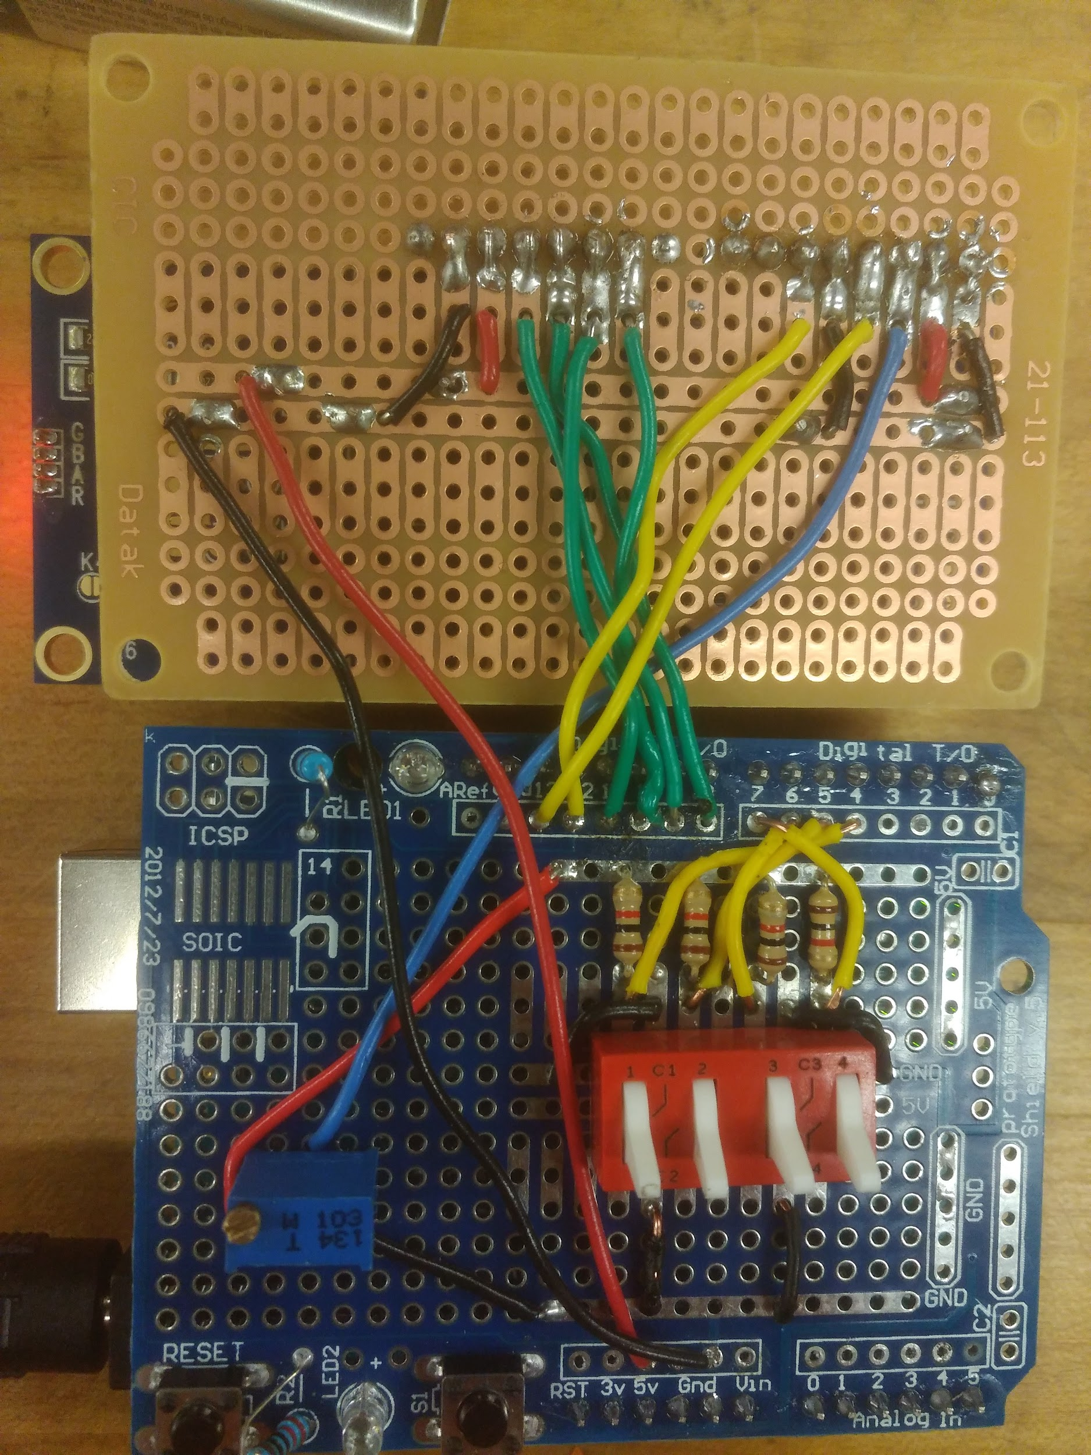
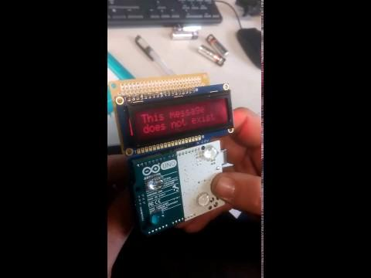
LAB 4 - Finished Product
Picture
Picture
Picture
Video

Slide 29
LAB 4 OBSERVATIONS
We had a slight issue with figuring out how to get the switches to work but after that, the lab went smoothly for the prototype version. When we started the final product of the display, there were a couple issues with the soldering and where the components were going. We had to change boards because the wrong one was used. Once that was all sorted out, the end product looked nice.

Slide 30
Solar Tracker - Description
This lab called for us to use photo sensors that would track the sun. We were to use arduino for the coding and to then put together a nice product for the end result.

Slide 31
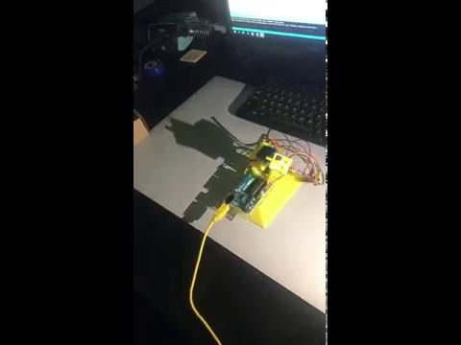
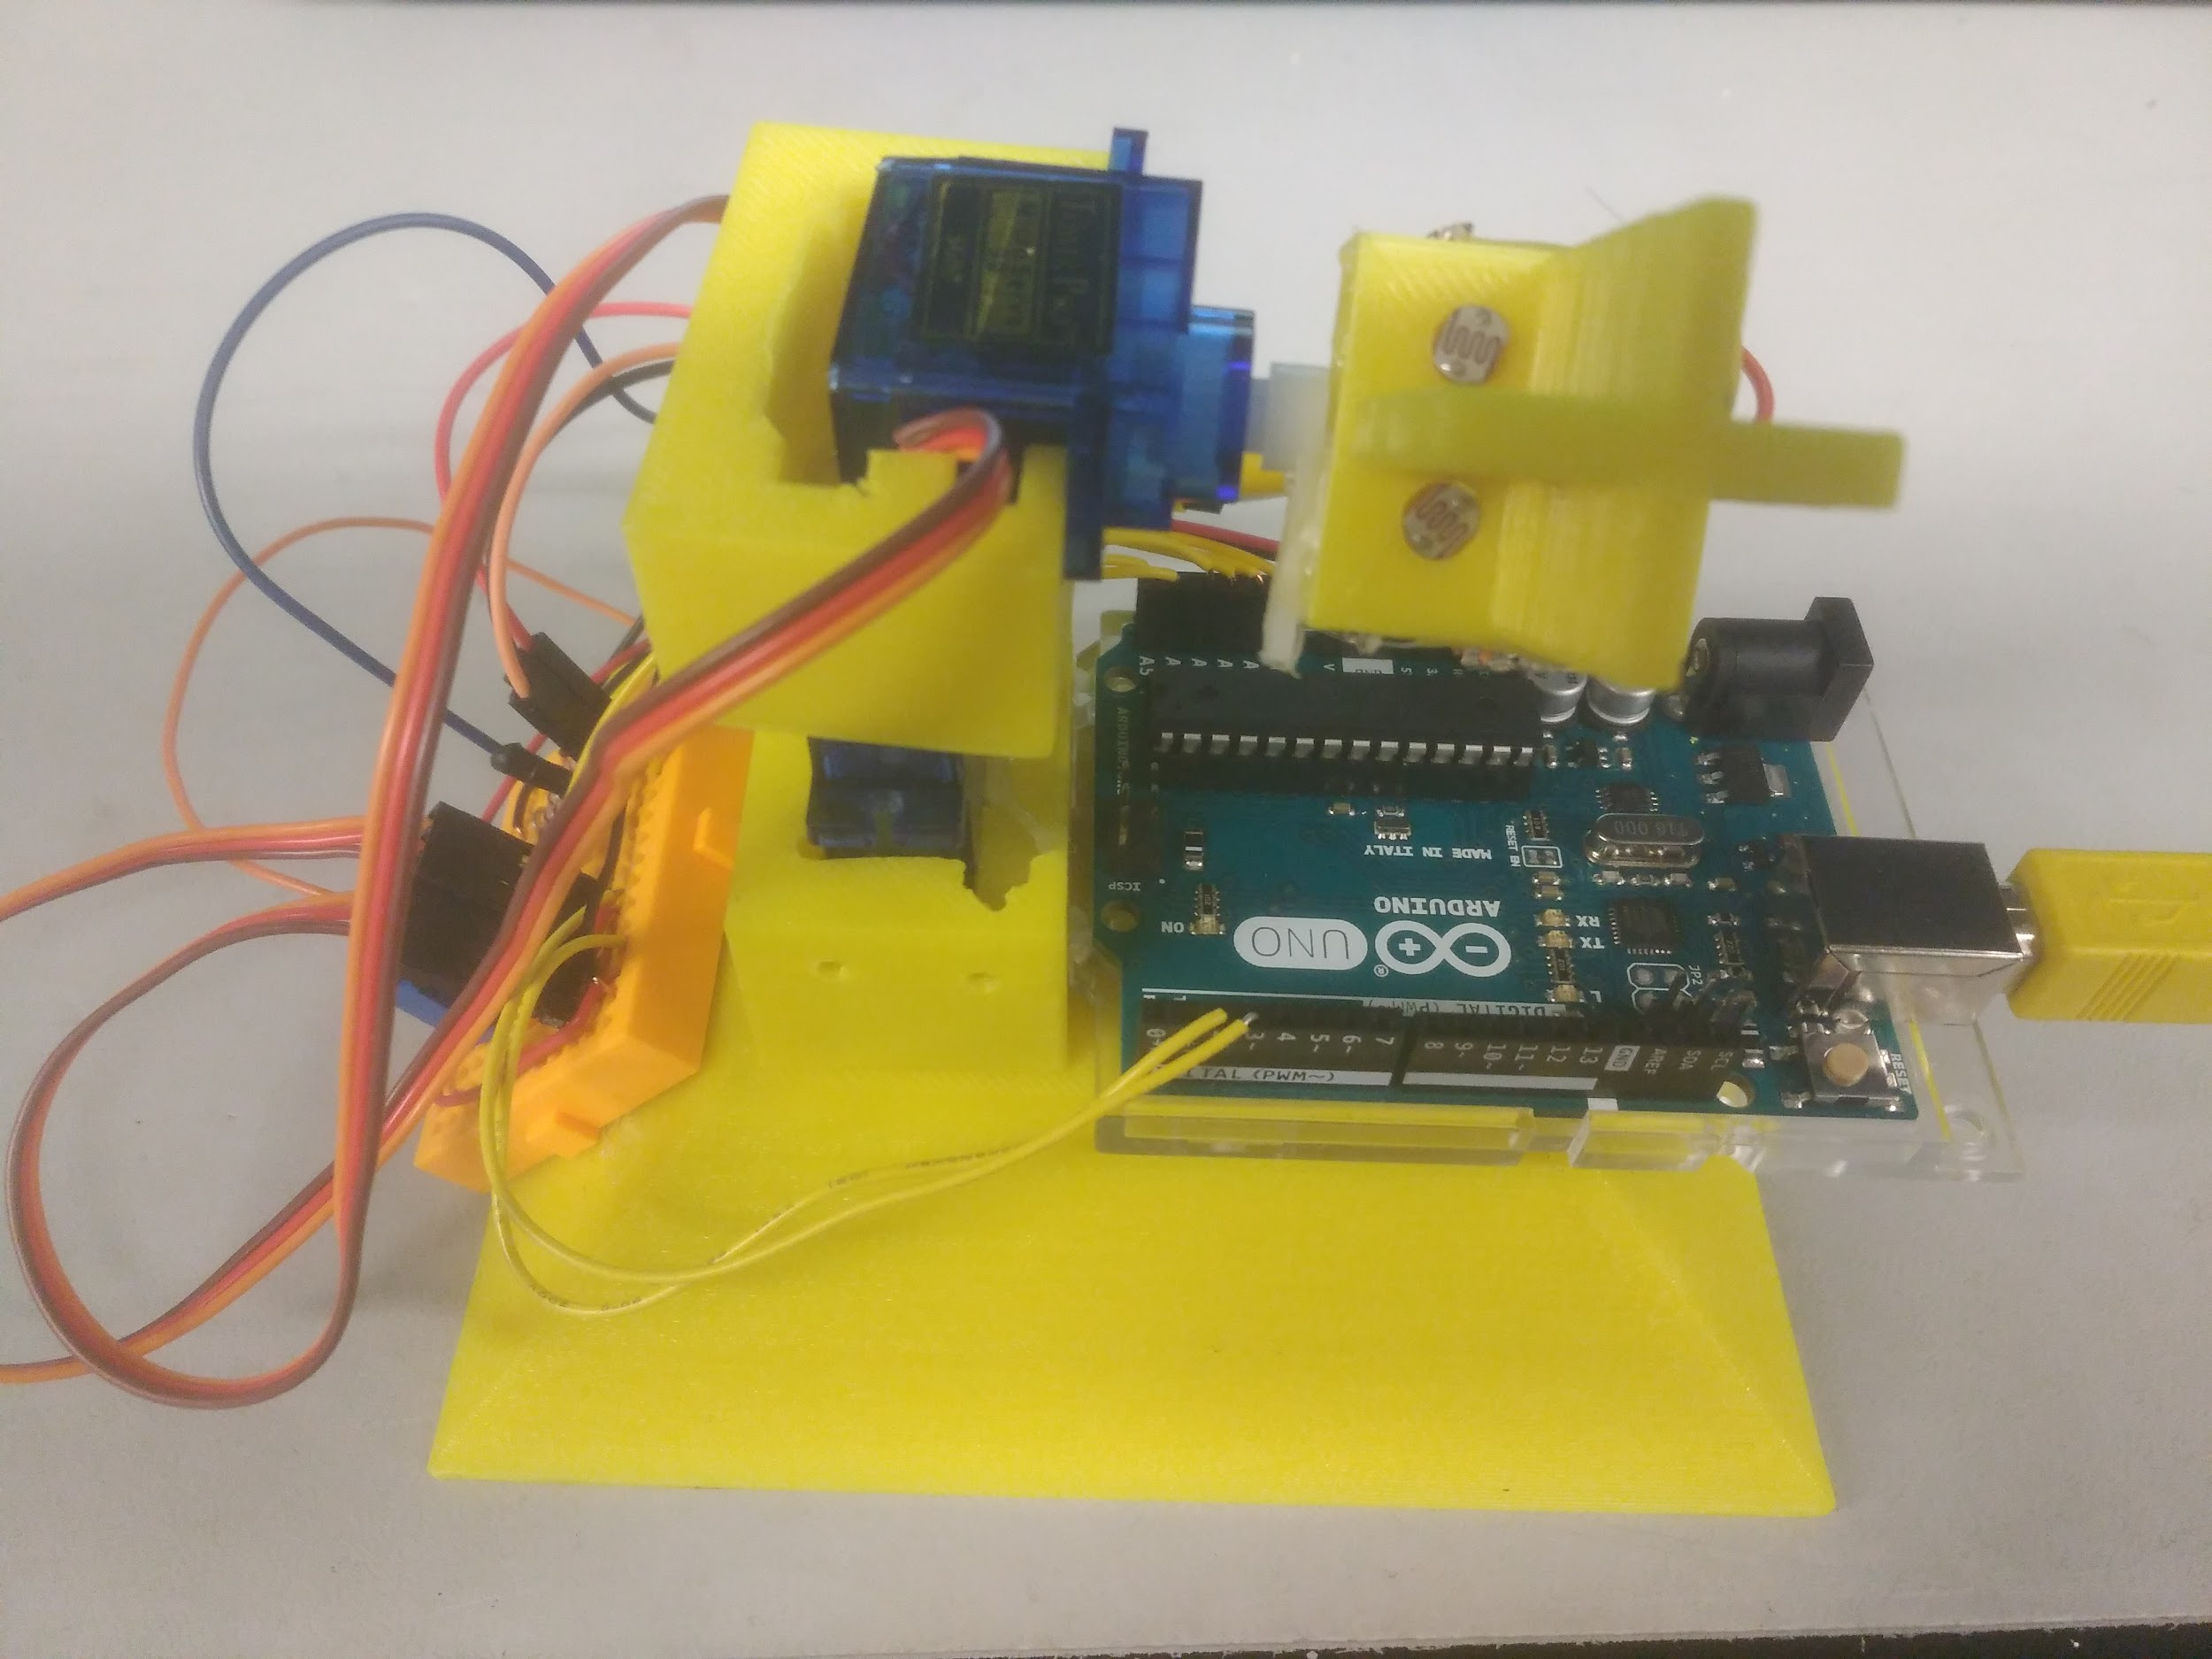
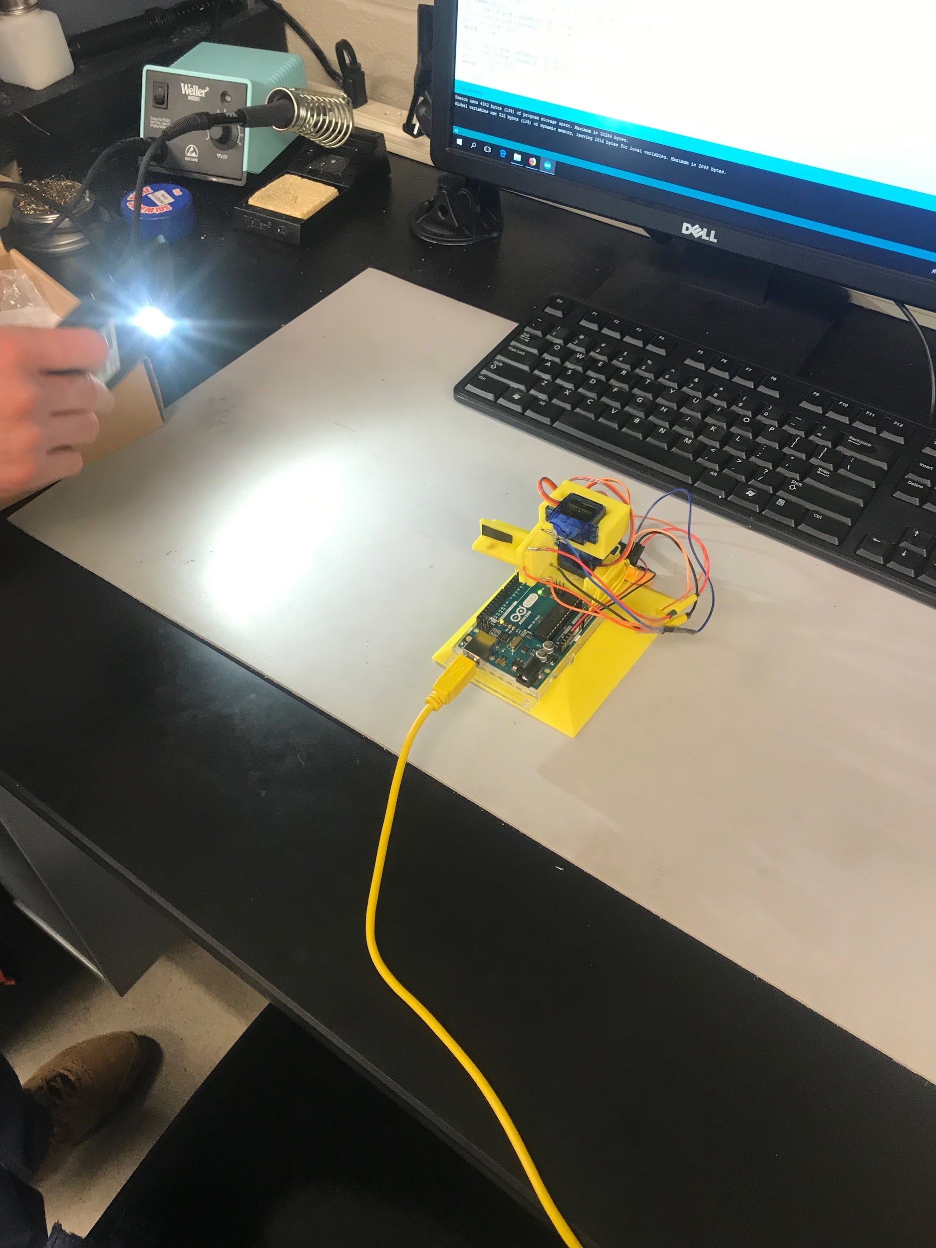
Solar Tracker
Video
Picture
Picture

Slide 32
Solar Tracker Code
if ((a + c)*potA - threshold > (b + d)) y++;
else if ((a + c)*potA + threshold < (b + d)) y--;
y = min(max(0, y), 180);
servoA.write(y);
delay(25);
}
#include <Servo.h>
Servo servoA;
Servo servoB;
void setup() {
servoA.attach(2);
servoB.attach(3);
Serial.begin(9600);
}
int x = 90;
int y = 90;
boolean goHome = false;
void loop() {
if (goHome) {
servoA.write(90);
servoB.write(90);
return;
}
double potA = analogRead(4)/512.0, potB = analogRead(5)/512.0;
potA = 1;
// potB = 1;
int a = analogRead(0), b = analogRead(1), c = analogRead(2), d = analogRead(3);
int threshold = 20;
if ((a + d)*potB + threshold < (b + c)) x++;
else if ((a + d)*potB - threshold > (b + c)) x--;
x = min(max(0, x), 180);
servoB.write(x);

Slide 33
Solar Tracker - Observations
I think that if we stayed consistent with completing this lab, it would have worked out better. We went back and forth with this lab and others throughout the semester and I think it made it a little bit tougher. We had an issue with the sensor being “jittery” when it was tracking the light.

Slide 34
Fish Feeder - Description
We were given the task of making code that will cycle a wheel which will release fish food pellets each day. Once it cycles through all seven of the wholes, a hole per day, it is then to return to the original position to start over for the next week.

Slide 35
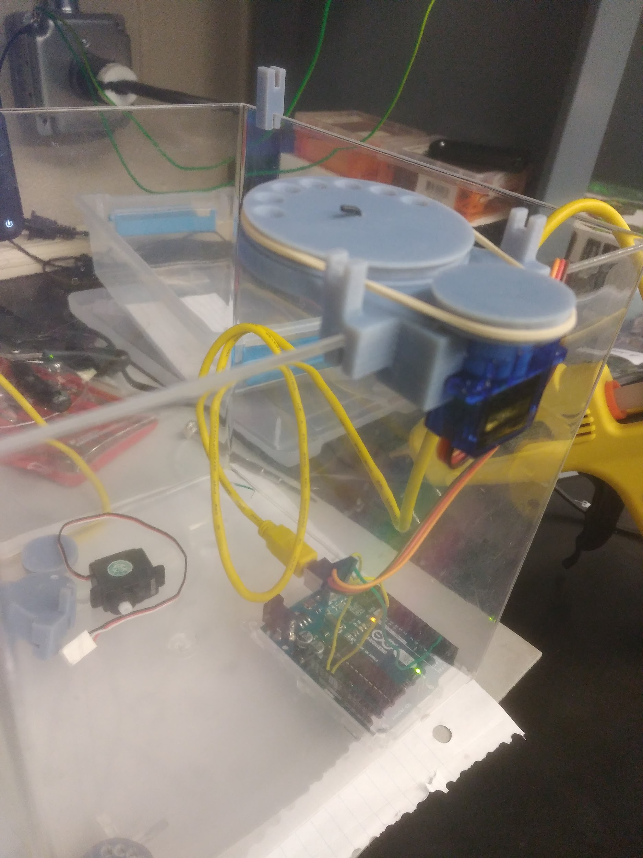
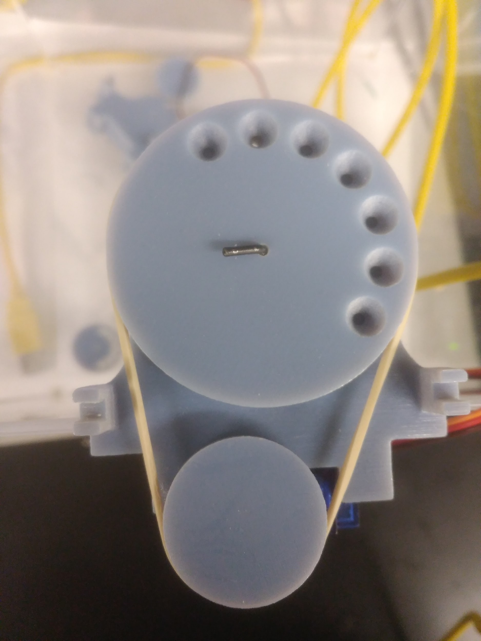
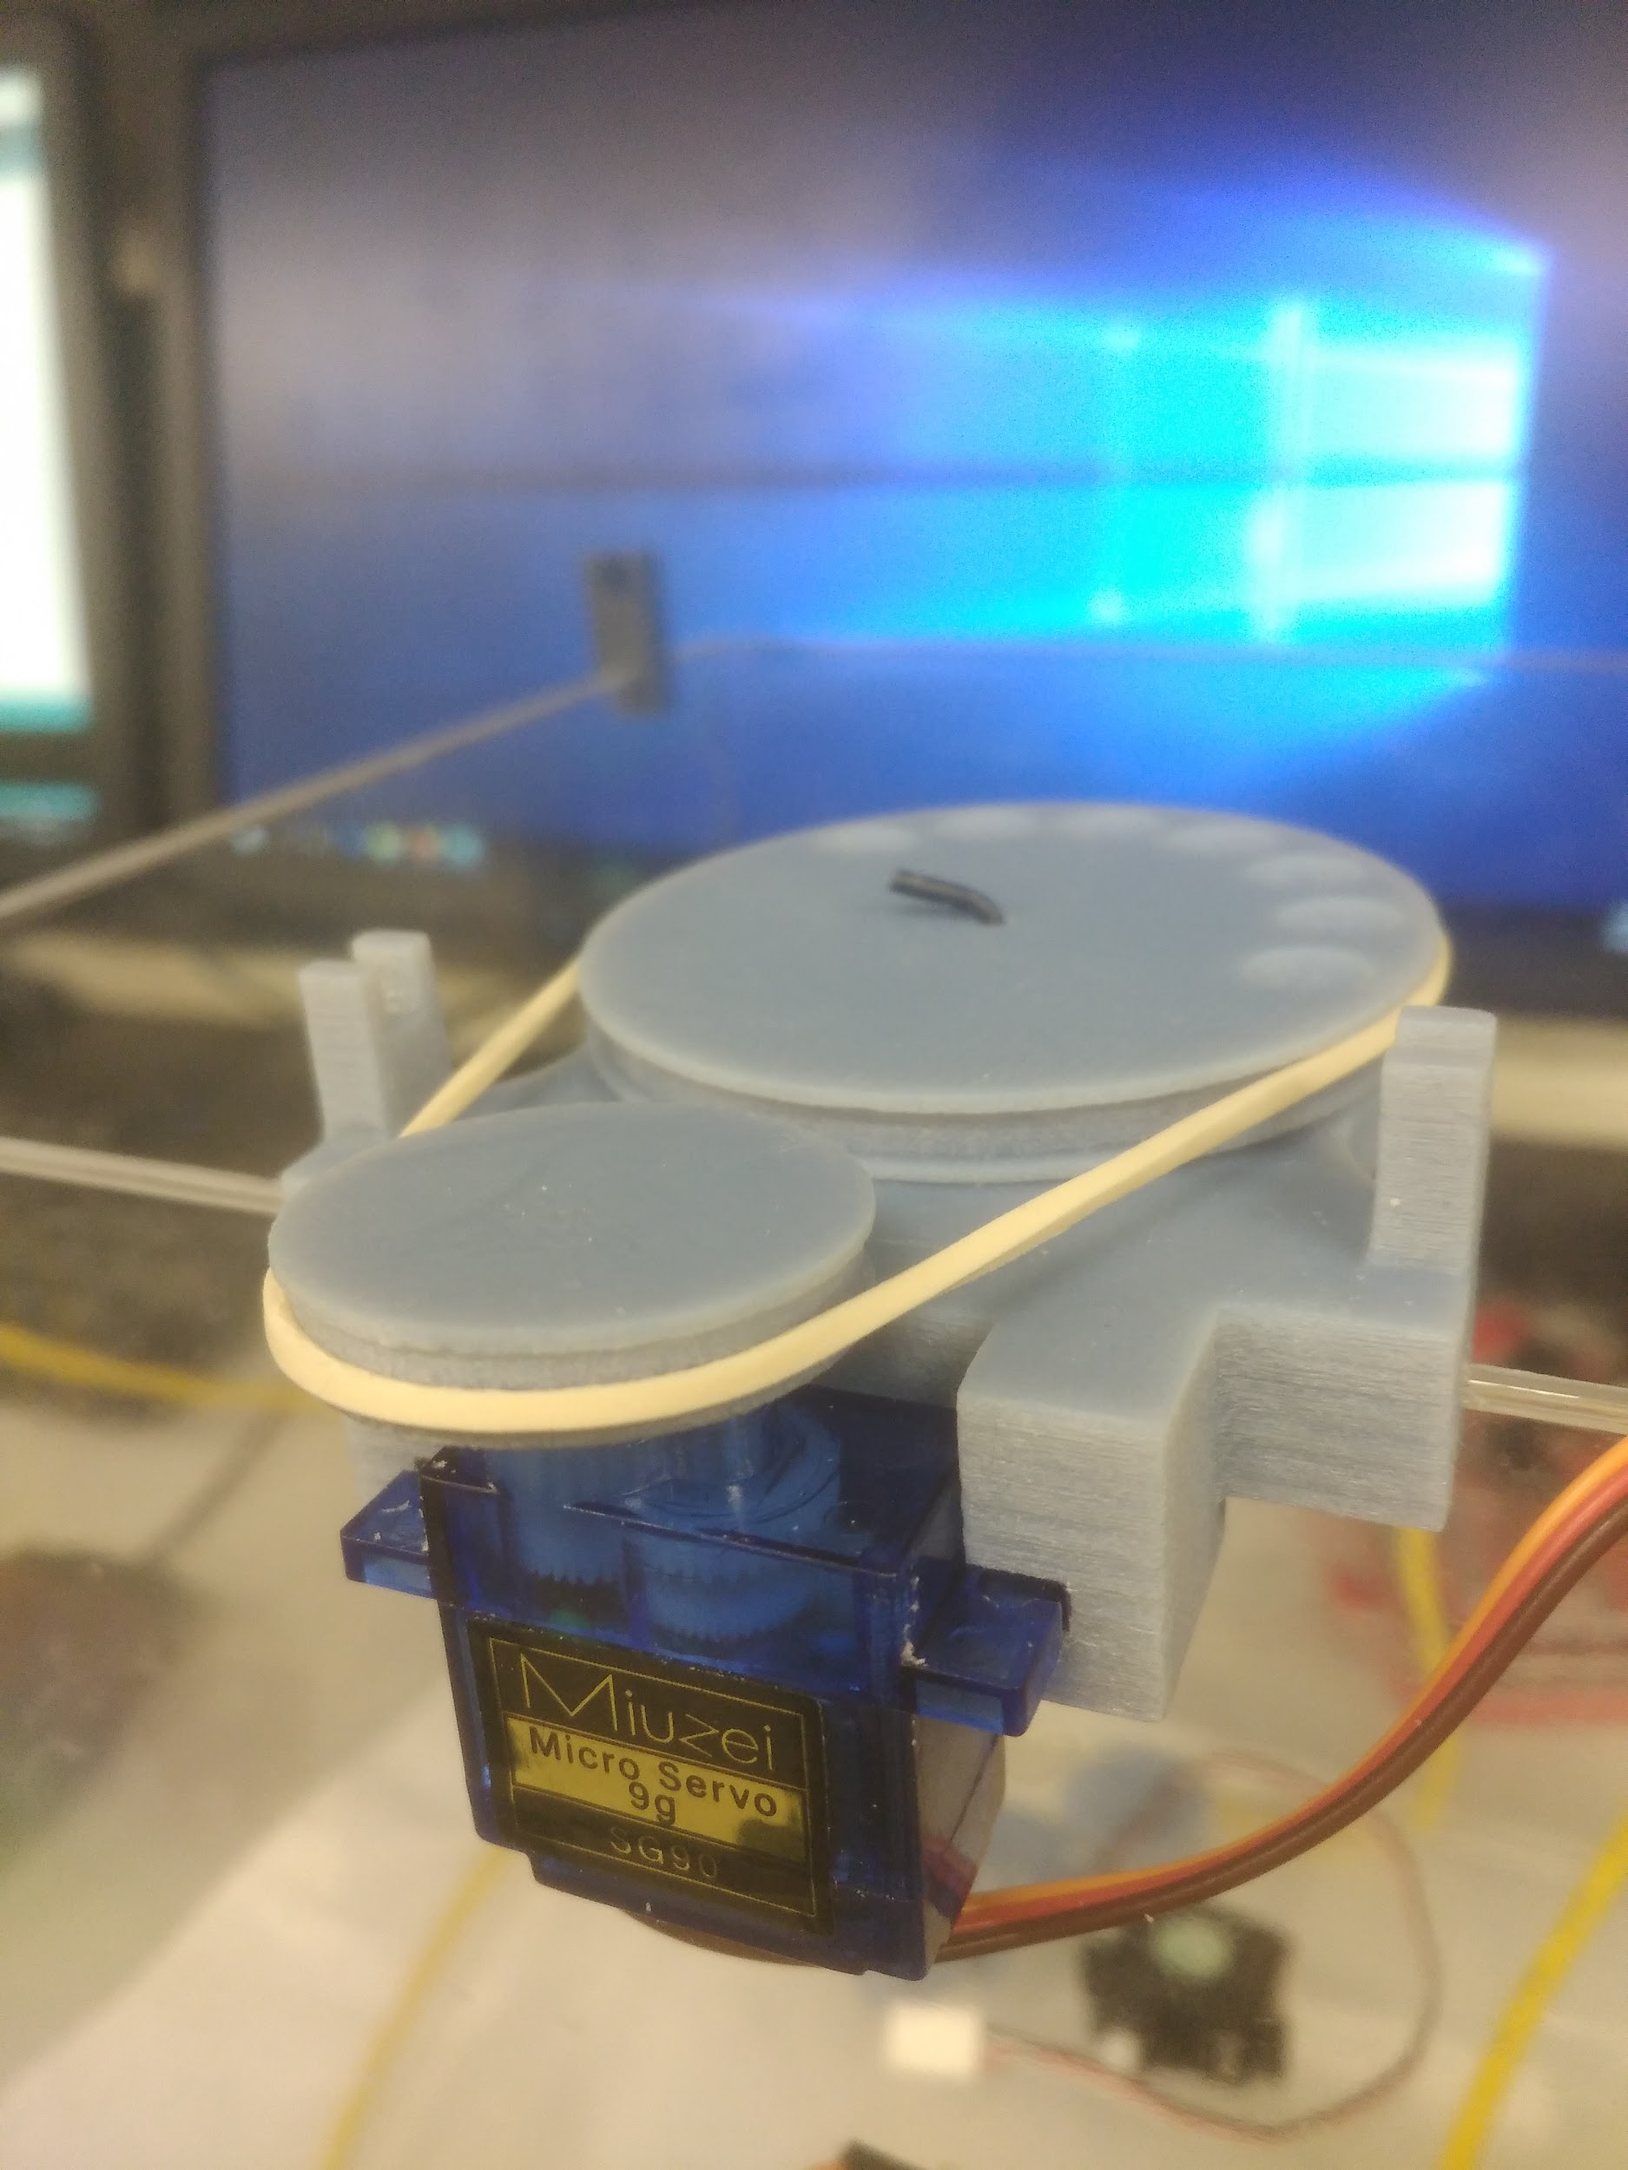
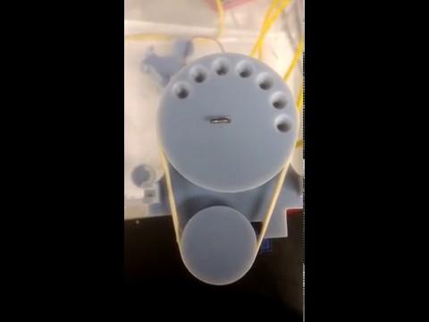
Fish Feeder
Picture
Picture
Picture
Video

Slide 36
Fish Feeder - Code
#include <Servo.h>
#include <math.h>
Servo servo;
const float increment = 180 / 8;
float location = 0;
const unsigned long msPerDay = 2 * 1000;// 1000 * 60 * 60 * 24;
int movements = 0;
unsigned long previousMovementTime = 0;
void setup() {
servo.attach(3);
servo.write(0);
}
void loop() {
if (millis() - previousMovementTime > msPerDay) {
location += increment;
movements++;
previousMovementTime += msPerDay;
servo.write(round(location));
if (movements >= 7) {
delay(1000);
location = 0;
movements = 0;
servo.write(0);
}
}
}

Slide 37
Fish Feeder - Observations
We were not able to finish the fish feeder because the 3D printed objects were not finished on time like planned. We were able though, to get the other parts of the project finished like the code.

Slide 38
Raspberry Pi 2.8 Display - Description
This lab was to basically to get the 2.8 or 3.5 display up and running by using the Raspberry Pi equipment.

Slide 39
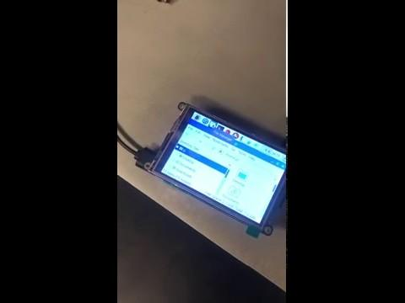
Raspberry Pi 2.8 Display
Video

Slide 40
Raspberry Pi 2.8 Display - Observation
The lab took about a night to complete but it also took a really long time to download certain things to operate the display. We had to download the OS onto a micro sd card but we needed to get a convertor for the micro sd. So that took a long time to find. Then, the download speeds were very slow. Once they were downloaded, though, it was up and running.

Slide 41
Raspberry Pi 7” Display - Description
The object of this lab was to also get this up and running just like the smaller displays.

Slide 42
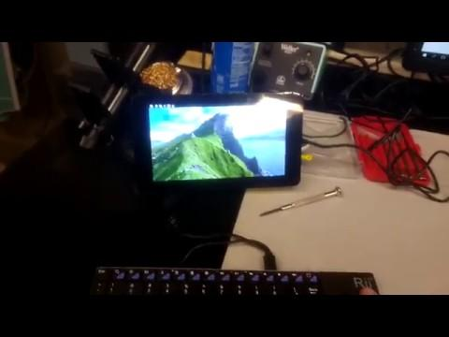
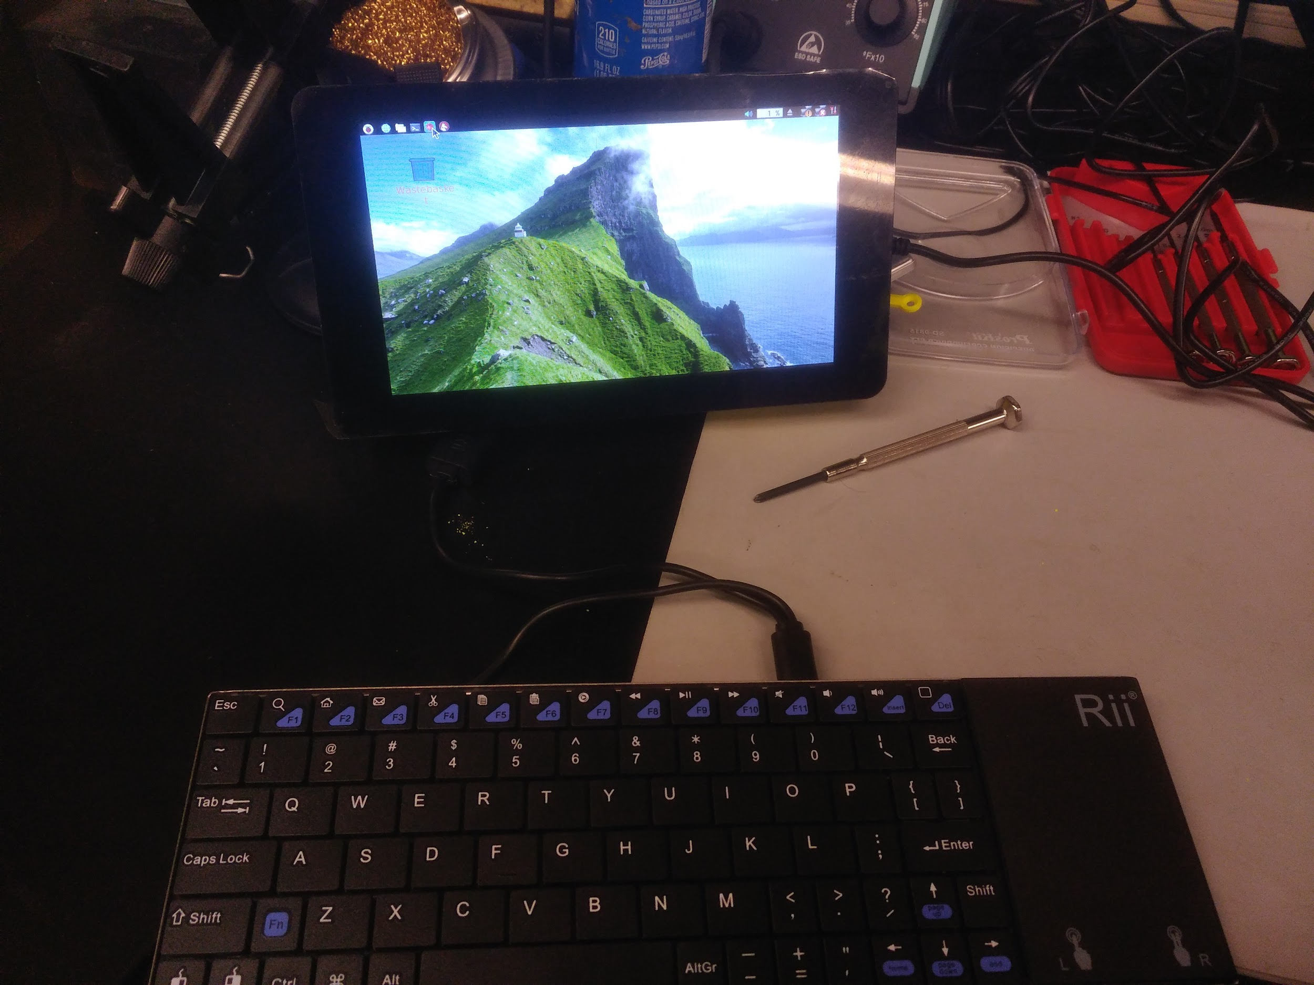
Raspberry Pi 7” Display
Picture
Video

Slide 43
Raspberry Pi 7” Display - Observation
The display and the programming was already done. It was missing the battery that was supposed to go with it. So we needed to add the battery and make sure that it actually worked. We also plugged the raspberry pi eyes into this display and got them to display on the screen as well.

Slide 44
Raspberry Pi Eyes - Description
The eyes that were given to us “worked” except for one of them. We needed to make them work and fix the other display.

Slide 45
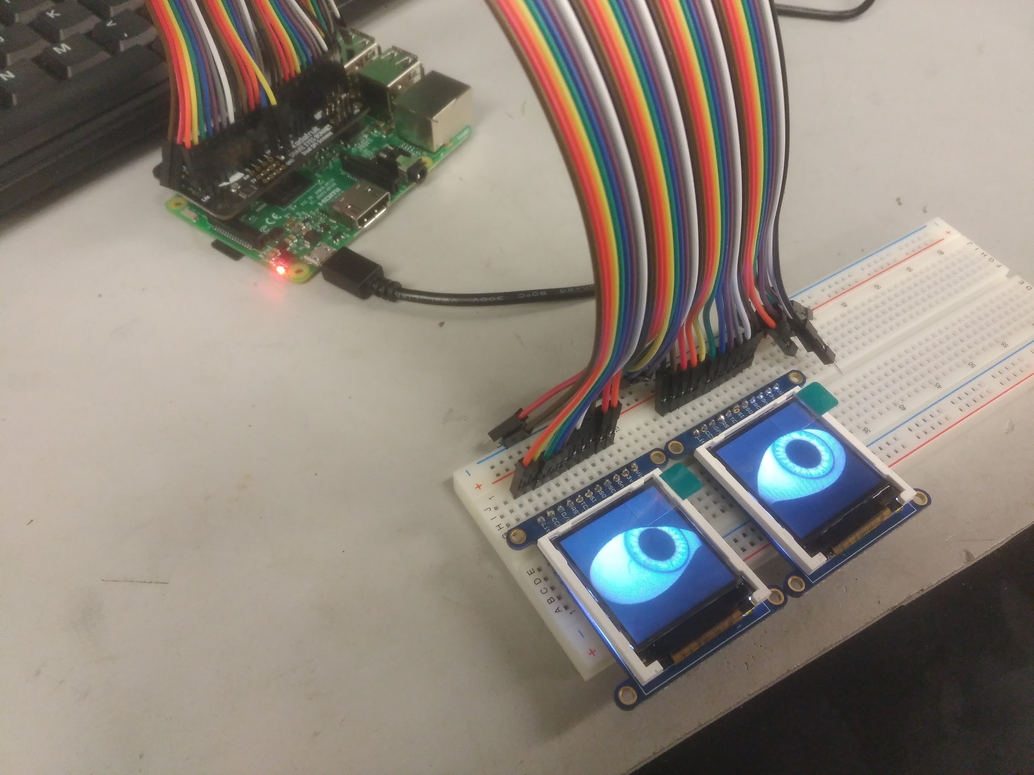
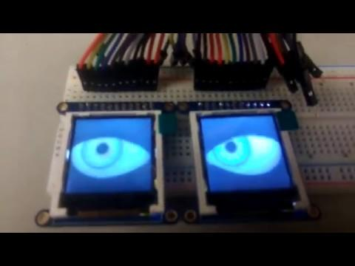
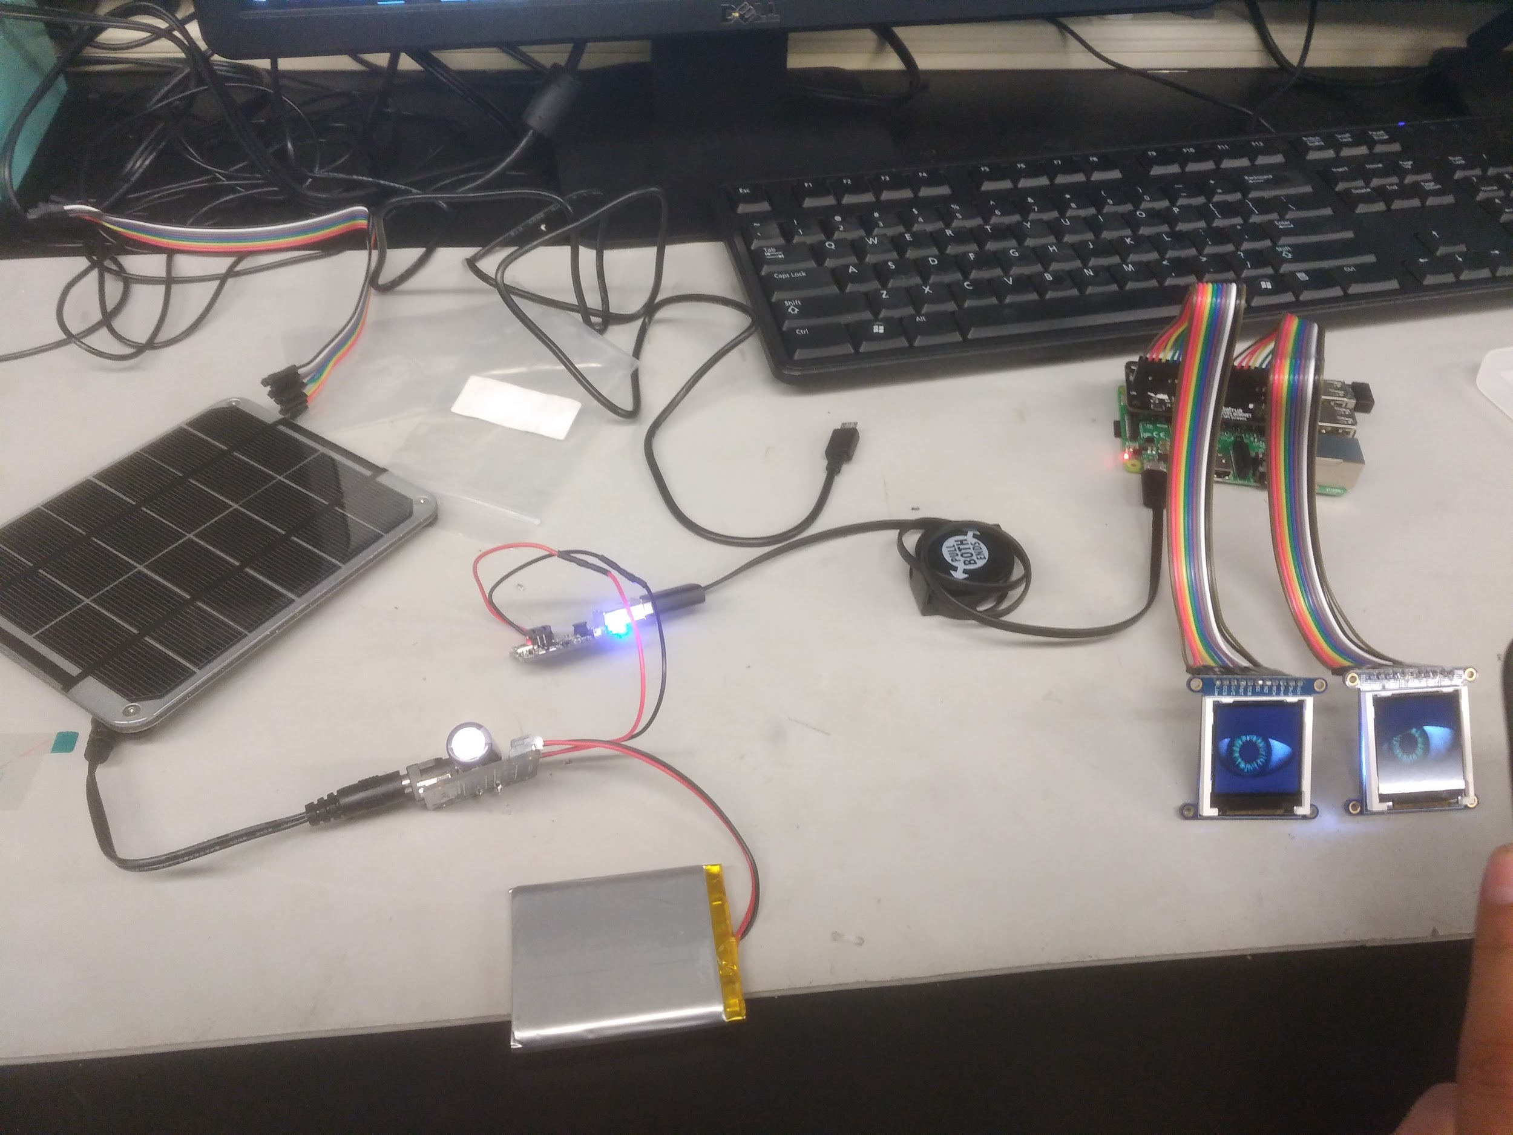
Raspberry Pi Eyes
Video
Picture
Picture

Slide 46
Raspberry Pi Eyes - Observation
The soldering for one display wasn’t secure. It wasn’t even connected to the board. So we resoldered it and that's really all that we needed to do with it. The program worked as well.

Slide 47
Two and Four Legged Bot - Description
These robots came as a kit and a “manual” that told us that the real manual is online. Then we were to make the robots operate as well.

Slide 48
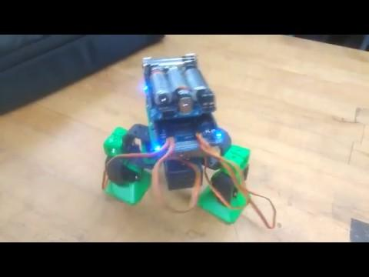
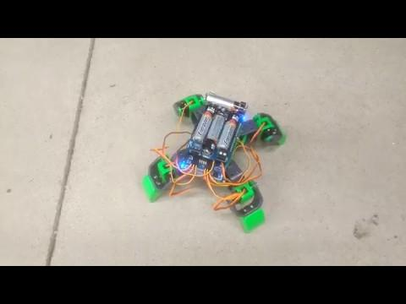
Two and Four Legged Bot
Video
Video

Slide 49
Two and Four Legged Bot - Observation
There was an issue with the servos where we tightened the screws too tight. We were able to send the servos back to distributor and get new ones. The two legged bot came with a transmitter that you can connect to your phone via the audio port. This made it possible to manually control it from your phone as long as you download their free app as well. We were not able to make it work. Even after changing the code to be able to receive the transmitter.

